Slide 1
Starting a Product
Course ICT Entrepreneurship
Prof. Sjaak Brinkkemper
Dr. Gerard Wagenaar
Notes:
1

Slide 2
What makes a Software Product
A software product is defined as
a packaged configuration of software components or a software-based service, with auxiliary materials, which is released for and traded in a specific market.
So, how do you establish your:
Application
Market
Software components
Package
?

Slide 3
Methods and stages for software startups
Abundance of scientific and grey literature
Many websites with support materials
Mostly focussing on general startups, fewer on software startups
Lots of stage models, mostly related to venture financing
Few about methods: what and how to do things

Slide 4
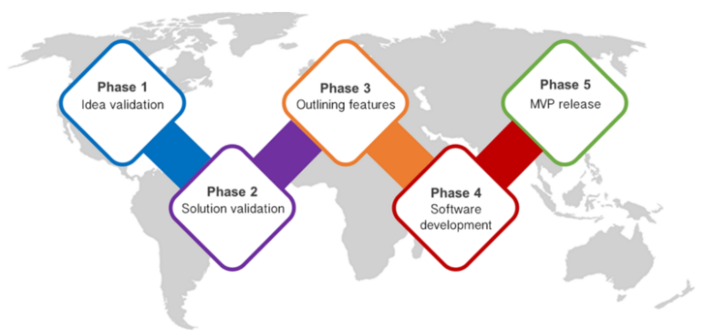
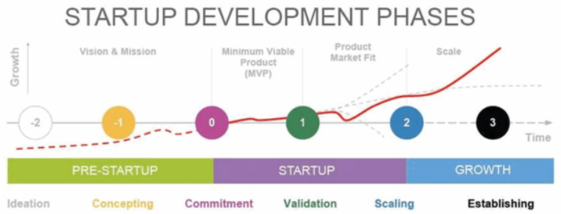
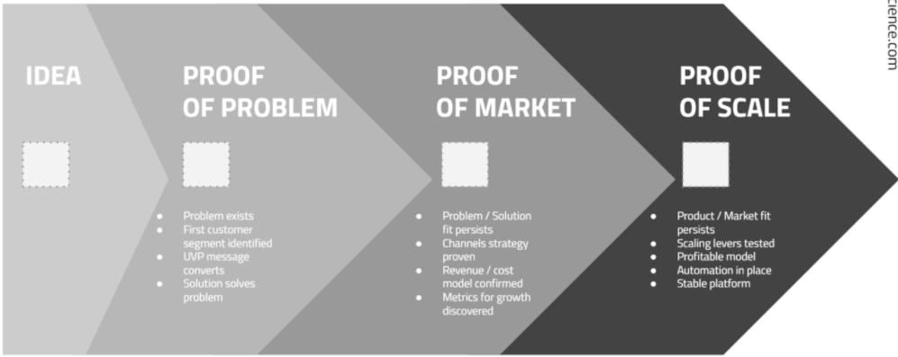
Startup stage models

Slide 5
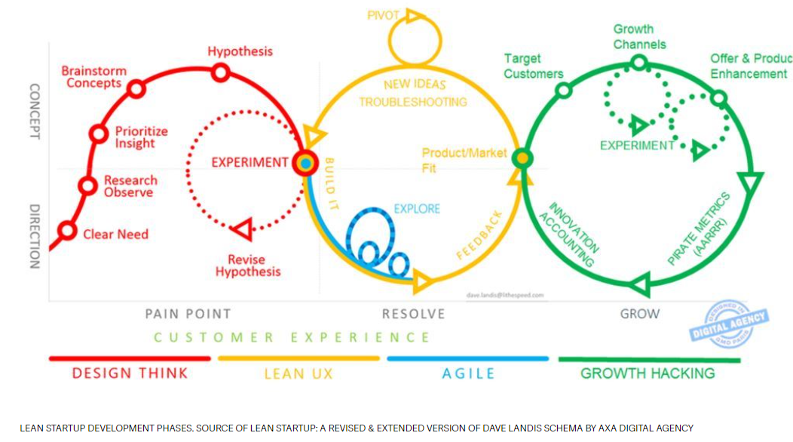
Lean startup approach

Slide 6
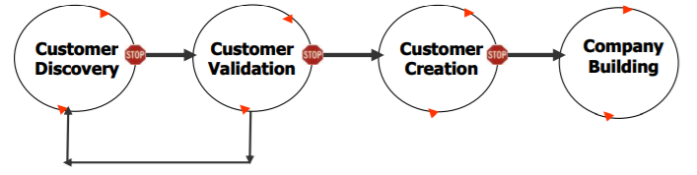
Customer development model
Customer discovery: who are customers for product and whether the problem it solves is important
Customer validation: proves existence of customer segment; market reacting positively to product and willing to procure.
Customer creation: create end-user demand and drive demand into sales channel
Company building: transition from informal and learning into formal mission-oriented departments with sales, marketing and business development.
More in: Blank, S. (2020). The four steps to the epiphany: successful strategies for products that win. John Wiley & Sons. (pdf on web)

Slide 7
Discussion
Video on, mic unmute when speaking, use chat for sharing
How do you envision your approach?
Did you find some suitable model with background information?
How can we share insights?

Slide 8
Papers on methods for Product Software companies
This presentation:
From: Bosch, Jan; Olsson, Helena Holmström; Björk, Jens; Ljungblad, Jens; The early stage software startup development model: A framework for operationalizing lean principles in software startups, Lean Enterprise Software and Systems, pp. 1–15, 2013, Springer Berlin.
Salamzadeh, A., & Kawamorita Kesim, H. (2015). Startup companies: Life cycle and challenges. In 4th International conference on employment, education and entrepreneurship (EEE), Belgrade, Serbia.
Wang, X., Edison, H., Bajwa, S. S., Giardino, C., & Abrahamsson, P. (2016, May). Key challenges in software startups across life cycle stages. In International Conference on Agile Software Development (pp. 169-182). Springer, Cham.
Carmel, E. and Sawyer, S., (1998) "Packaged Software Teams: What Makes Them So Special?," Information Technology & People, 11(1), 6-17
Carmel, E. (1995). Time-to-completion factors in packaged software development. Information & Software Technology Vol. 37, Num. 9, 1995, pp. 515-520

Slide 9

How nature protects weak products

Slide 10
Software start-up study
Erran Carmel:
A Process Model for Packaged Software Development
Time-to-completion in software package startups
Study of 12 starting product companies software
Investigation of successful approaches in the acceleration of software production
In tailor-made software world: “Software is always late”

Slide 11
Process model for product software
Idea
Formulating idea and prototyping
Design and code until quality threshold is reached
Requirements loop
Frozen specifications
Quality loop
General release
Notes:
A software process model is a standardised format for 1) planning 2) organising, and 3) running a development project. Describes: Sequence of activities of a Software Engineering project, and their relative order.
The process model of Carmel is based on two central constructs: 1) a requirements loop; and 2) a quality loop. The loops are separated by a stage in which requirements specifications are frozen.

Slide 12
Requirements loop
Idea
A
Internal review
External review
Preliminary requirements
Concept Go/No GO
Initial screening
Satisfaction decision point
Initial reqs and technical specs
Freeze specifications
Build prototype and refine
Frozen specifications
A
Notes:
The requirements loop's goal is to discover requirements early and comprehensively. It is incremental (relying on prototyping), has several evaluation and exit points, and structures involvement of customers and other external sources such as marketing.

Slide 13
Quality loop
Frozen specifications
C
Beta tested product
Beta test
B
Design
Release build
B
QA Point
Code
B
Defect removal
QA Point
Alpha tested product
Final testing
Alpha test
Packaging
B
QA Point
General Release
Defect removal
C
Notes:
The quality loop addresses the need to reduce defects. It begins with design and coding stages. It is also incremental and has several evaluation and exit points.

Slide 14
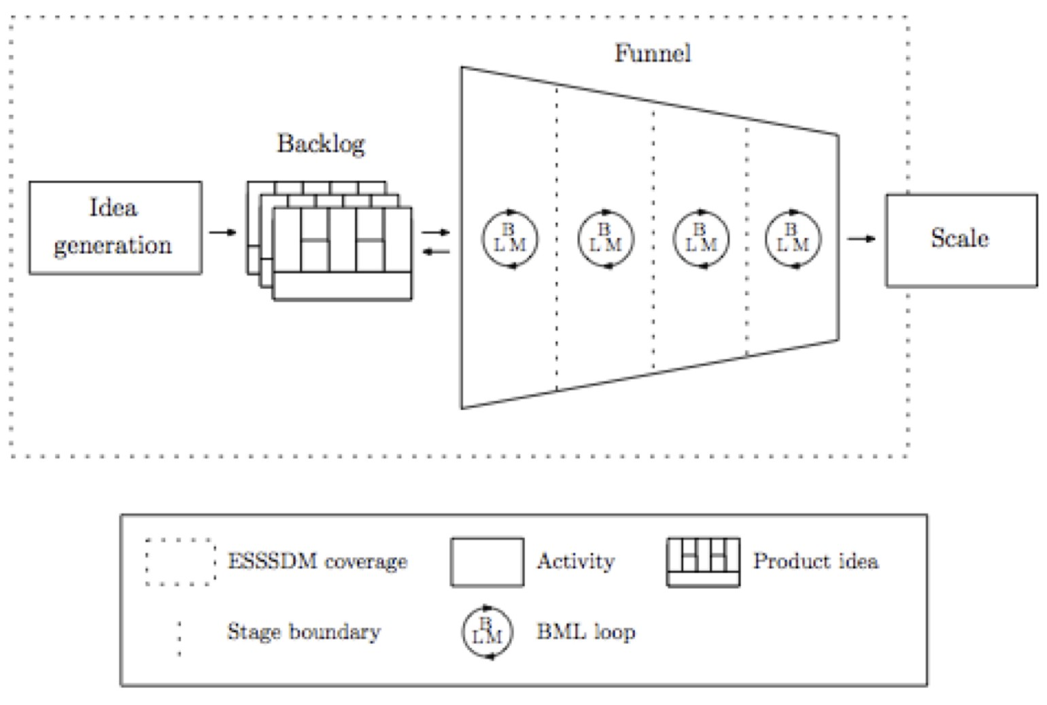
The Early Stage Software Startup Development Model - ESSSDM
BML: Build Model Learn
From: Bosch, Jan; Olsson, Helena Holmström; Björk, Jens; Ljungblad, Jens; The early stage software startup development model: A framework for operationalizing lean principles in software startups, Lean Enterprise Software and Systems, pp. 1–15, 2013, Springer Berlin.

Slide 15
Background
Time-based competition in business
Time-to-market is:
measure of calendar time from beginning of product development to product release
Release of new car model: 36 months
Release of new smart phone: 22 months
Release of new software product: ?
Justification:
Fast pay-back of R&D investment
Faster cycles of product renewal
What about software product ?
Notes:
All businesses operate within an environment of time-based competition.
For product development this means completion.

Slide 16
Productivity in software
Definitions
Productivity = effort per time unit * person
Effort ≅ Lines of Code (LOC)
Standard productivity: 20 LOC /personday
In order to be predictable for future releases it is imperative to collect data from the beginning
Professional atmosphere
Not used against persons
Precision of data is not an issue

Slide 17
Productivity accelerators
Development method (life cycle model):
water-fall: complete stages
spiral: start from core release
incremental: build architectural chunks
evolutionary: adapt according changing wishes
Development team
individual characteristics
group characteristics
Resources
labor
tools, infrastructure,
office space, environment, social
Notes:
Carmel made an exploratory study of time-to-completion accelerators in twelve software package startups.

Slide 18
Productivity accelerators (2)
Project Management
managing people, milestones, resources and tasks
style and tools
Risk Analysis
identifying, assessing, and managing risks
Incremental Innovation
changes from one product to the next
1 and 2 in software research
Others from general product development

Slide 19
Research method
12 product software firms
Revenue: 1 – 12 M$
US: Virginia – Maryland area
Products for desktop
Selected because of:
Breadth of product offering
Product complexity
Age of firm
Minimal success: products were purchased
Interviews with key developers (18)
Survey to team members (30 out of 48)

Slide 20
Firm characteristics
Firm # |  | 1 | 2 | 3 | 4 | 5 | 6 | 7 | 8 | 9 | 10 | 11 | 12
Application | Business/Office |  |  | √ |  | √ |  |  |  |  | √
 | Specialized | √ | √ |  |  |  |  |  |  | √
 | Systems / Utilities |  |  |  | √ |  | √ |  |  |  |  | √ | √
 | Graphics |  |  |  |  |  |  | √ | √
Distribution | Mass market |  |  | √ | √ |  | √ |  |  |  |  | √
 | Wide | √ |  |  |  | √ |  |  | √ |  | √ |  | √
 | Narrow/high end |  | √ |  |  |  |  | √ |  | √

Slide 21
Development time (in months)
Firm | First product | Subsequent product(s)
1 | ? | 24
3 | 26 | In development
4 | 5 | 24
5 | 13 | None
6 | 36 | 11,12,13,13
7 | ? | 6,8,12,2
8 | ? | 19,10,9
9 | 48 | 18
11 | 24 | 18,36
12 | 38 | 9
Avg. | 26.0 | 14.3
Data were rough estimates
Multiples of 12
Hardly a time strategy, when asked
Time-to-completion unknown
Deadlines not so important
Competitive pressures
Market pressures

Slide 22
Acc. 1: Development method
Development method | Degree of implementation | # Firms
Specifications | None Informal, brief, a few pages Formal specifications | 2 7 3
Design | Informal, brief, minimal Formal and distinct stage | 8 4
Prototyping | No data None Little or rarely Prototyping actively used | 1 3 1 7
Testing | Informal or non-standard Formalized phases | 6 6

Slide 23
Development method findings
Accidental life-cycle model:
custom system for one client is turned into software product
Methodical approach after release 1.0
Entrepreneural nature of firm
Shortage of money
Critical events
Method not in culture
Importance of software architecture
Not on paper
Known by every team member
Use of Prototyping
Proof-of-concepts, Mock-up, demos
Decreases time-to-completion
Increases quality
Overlapping phases
Poor planning (or perhaps more agile?)

Slide 24
Growth stage model
Idea
Version 1.0
10 employees
20 employees
Inception
First steps
Transition
Rapid growth
Development method
Ad hoc
Necessary steps
Config. Mgmt
Error sheets
Elements of formal method
Organization
Core team forms
Non-development staff added
Additional development staff added
Quality assurance
Minimal
Some
Formalization begins
# firms in this study
0
5
3
4

Slide 25
Acc 2: Development Team
Essential factor
Core team
Homogeneous
Highly motivated
Highly experienced
History of working together
Core team
Architect
Principal programmers
Cohesive
Dense communication
Whole duration
The Company
Development Staff
Core

Slide 26
Size of team related to age
Firm
Years since release of first product
Total number of employees
Company
Development Staff
Core team
5
<1
6
3
3
12
2
8
3
3
8
2
8
4
3
3
2
5
3
3
9
3
13
7
4
2
3
20
6
6
1
4
10
6
3
4
5
45
5
4
6
6
70
45
4
11
6
57
35
6
7
7
50
11
4
10
9
20
11
5
Avg.
4.2
26
11.6
4

Slide 27
Core team findings
Size
About 4
No growth during growth of company
Composition
Most between 20 and 30
Male, American
Varying education: from high school to PhD
Very high motivation levels
Stock options
Good wages

Slide 28
Quotes
There are six of us who know the intimate details of what the product does
There are at most 100 pages of design … and no one knows where that is anymore – it’s in peoples’ brains
The core team members were in one room – like one brain – no phone calls, no interruptions
All we need is at most 4-5 developers, even if we get to be a $10 million company. We couldn’t survive with any more.
Notes:
28

Slide 29

More on the core team
Experience
Computer science
Application domain essential
13 years experience in programming
Duration of co-work
Before joining core team
Team structure
Amorphous
Some with strong player
Others no dominant leader

Slide 30

Acc. 3: Resource allocation
Labor is a flexible resource
Hire temp help
Relocate project members
Finding: no labor added
Extra time of team
87% work more than 56 h/week
47% work more than 71 h/week

Slide 31
Capital investments
Little investments in tools
Non used design tools
Less than 1000 USD / year * developer
Freeware/shareware utilities
Trial versions from customers/vendors
In-house developed utilities
Test software
More investment than on outside tools
Distrust in others’ software

Slide 32
Acc. 4: Project Management
Usage of PM
6 companies use formal PM tools, scheduling, timelines.
1 (of these) used PM tool all of the time
Others use nothing
Meetings
1 or 2 meetings per week for key developers
Coordination in less formal channels

Slide 33

Acc. 5: Risk Analysis
No systematic approach to risk analysis
Risk management at the end of project
Reduction of time to completion
Quality versus functionality
No formal policies

Slide 34
Acc. 6: Incremental Innovation
Many firms applied incremental innovation
Product families
Closely related products
Derivation from other products
New versions regular time intervals
Manageable updates (service packs)
Niche innovation in their markets
Established new niches

Slide 35
Additional accelerator: Quality
Testing is complex and consumes time and resources
Testing was compromised
Quality assurance: making sure that a product fulfills certain prescribed quality properties
QA was absent
Weak methods
Lost in discussions on time and functionality

Slide 36
Lessons from this study
Core team is the accelerator with the most impact on the time-to-completion
Recognized as an asset in companies
Cross functional, small size, selective staffing, motivation, full-time involvement
History of working together
Homogeneous, highly motivated, in-depth experience
Other accelerators present
Use of extra effort at the end of project
Building similar products
Remaining accelerators are weak
Weak awareness of time-to-completion
Deadlines were soft
Hardly a strategy for development speed
Poor recall of time spend on project

Slide 37
Implications for software start-ups
Founders of start-ups
Creation of successful core team
One talented developer not enough
Interesting product ideas and features not enough
Well-mixed, experienced team
How about Europe and Asia?
Cultural aspects
Working attitude
Seniority versus egalitarian

Slide 38
Challenges of Software Startups
Establishing a software startup is challenging.
Categories of challenges:
Team: main driver of development
Product: technologically innovative solution
Finance: company growth
Market: needs of the final customers

Slide 39
Research approach
Web-based survey
1. Introductory: definition and examples of software startups.
2. Background information about their organizations, domains, countries, roles
3. Learning processes and product development status.
4. Perceived challenges
Multiple choice, with one open-ended option
5389 respondents

Slide 40
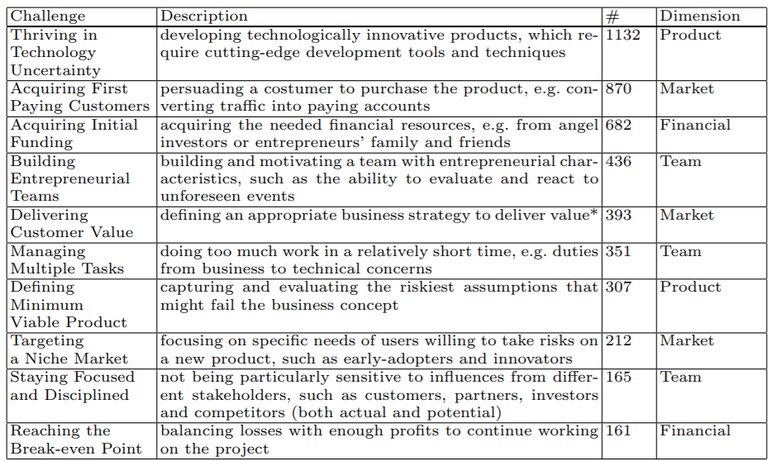
Most observed challenges

Slide 41
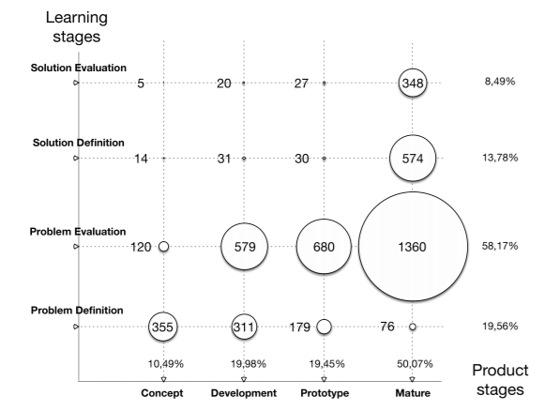
Challenges map to learning and product stages

Slide 42
Discussion: Challenges map
What do the trends mean and imply?
A
B
C

Slide 43
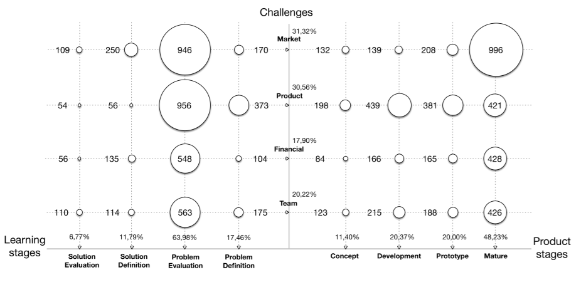
Challenge map

Slide 44
Conclusions from study
Small scientific body of knowledge
Initial explanation of the perceived and experienced challenges
Top challenges
technology uncertainty (21,01%)
acquiring first paying customers (16,14%)
Early-stage startups are too keen to develop mature products without understanding the business problem.
They continue to develop software, with little focus on the learning process by validating the problem/solution fit.

